Slide 1
Cyber Offences

Slide 2
Introduction
Understand different types of cyber attacks
Overview of the steps in planning cybercrime
Understand tools used for gathering information about the target. etc
Hackers :
Very talented, smart people who understand computers better than others
Hackers enjoy to learn and experimenting with the computers
Crackers :
“Breaks into computers”
Phreakers :
Breaks into phone lines.

Slide 3
Categories of Vulnerabilities
Inadequate border protection
Remote access servers (RAS) with weak access controls.
Application servers with well known exploits
Misconfigured systems and systems with default configuration.

Slide 4
How Criminals plan the attack?
Criminals use many methods and tools to identify vulnerabilities of their target.
Criminals plan attacks were categorised into
Active
Passive
Inside
Outside
Active Attacks:
Def: To alter the system
Affects: Availability, Integrity and authenticity of data.
Passive Attacks:
Def: To gain information about the target.
Affects: Confidentiality
Inside Attack :
Def: Attempted within the security perimeter of an organisation.
Affects: Access more resources than expected.
Outside attack:
Def: Attempted by a source outside the security perimeter (insider/outsider) who is indirectly associated with the organisation.
Sources: Either from internet or a remote access connection.

Slide 5
Phases to plan cyber crime
Information gathering. (passive attack)
Reconnaissance : To gain information about an enemy .
Starts with Foot printing.
Scanning and scrutinizing the information.
For the validity of the information.
To identify the existing vulnerabilities.
Launching an attack
Gaining and maintaining the system access.

Slide 6
Passive Attack
Information gathering about a target without their knowledge.
Ex: Watching a building to identify employees entering time
It is done using internet search or googling to gain individual or company information.
Google or Yahoo search to locate information about employees.
Tools:
GOOGLE EARTH: It is a virtual map of globe and geographic information program. It maps the earth by the superimposition of images obtained from satellite imagery and provides aerial photography of the globe
Ex: (www.earth.google.com).
INTERNET ARCHIVE: The internet archive is an internet library with the purpose of offering permanent access for researchers, historians and scholars to historical collections that exist in digital format (Ramot et al., 2003). It includes texts, Audio moving images and software as well as archived web pages in our collections.
Ex: (www.archiv.org).
PEOPLE SEARCH: People search provides details about personal information, date of birth, residential address, contact number etc. Ex: (www.whitepagesinc.com).
DOMAIN NAME CONFIRMATION: To perform searches for domain names using multiple keywords, this helps to find every registered domain name in “com”, “netr”, “org”, “edu” (www.namedroppers.com).
WHOIS: This is a domain registration lookup tool. This utility is used for communicating with WHOIS servers located around the world to obtain domain registration information. WHOIS supports IP address queries and automatically selects the appropriate server for IP address. This tool will lookup information on a domain IP address or a domain registration server or you can use the default option which will select a server for you (www.whois.net).
NSLOOKUP: The name nslookup means “name server lookup”, the tool is used on windows and Unix to query details, including up addresses of a particular computer and other technical details such as mail exchanger records for a domain and name severs of a domain (www.nslookup.downloadsoftware4free.com).
eMailTrackerPro: eMailTrackerPro analyzes the E-mail header and provides the IP address of the system that send the mail (www.emailtrackerpro.com).
HTTrack: This tool acts like an offline browser. It can mirror the entire website to a desktop. One can analyze the entire websites by being offline (www.httrack.com).

Slide 7
Active Attacks
ARPING: This is a network tool that
Broadcasts arp packets and receive replies similar to “ping”.
It is good for mapping a local network and finding used IP space
It broadcasts, who has an arp packet on the network and prints answers.
It is very useful when trying to pick an unused IP for a net to which routing does not exist as yet
Bing: This tool is used
for pinging the bandwidth.
It is one of the point-to-point bandwidth measurement tool
It can calculate the blank throughput between any couple of networks. (htttp:ai3.asti.dost.gov.ph/sat/bing.html).
It is also called “Rattling the doorknobs” or “Active reconnaissance”
It can provide confirmation to an attacker about security measures in place .
Tools:
Dsniff : This is network auditing tool to capture username, password and authentication information on a local subnet.
DNStracer: This tool is used
for determining the data source of a DNS server
Notifies the continuous process of DNS server
Hmap: This tool is used
To get the fingerprinting of web servers
to identify the version of server, vender of the server, model of the server and more
Nmap: This tool is used
to scan the port address of the network,
It takes the fingerprint of operating system version, service and it can scan the network rapidly (http://insecure.org/nmap).

Slide 8
Scanning and scrutinizing gathered Information
Objectives of scanning:
Port Scanning : Where information goes in and out of a computer
Identify open/close ports and services
Network Scanning: Understand IP addresses and computer network systems information.
Vulnerability Scanning: Understand the existing weaknesses in the system.
Scrutinizing : “Enumeration”
Objectives:
1. Valid user or group
Network resources and /or shared resources
OS and different applications that are running on the OS
S.No | Port Number | Port Description
1 | 1 | TCP Port service Multiplexer
2 | 18 | Message send protocol
3 | 20 | FTP data
4 | 25 | SMTP
5 | 43 | WHOIS

Slide 9
Launch the Attack
After scan and enumeration, the attack is launched using the following steps:
Crack the password
Exploit the privileges
Execute the malicious commands/applications
Hide the files
Cover the tracks like delete the access logs.
Note:
The attackers spend 90% of the time in Reconnaissance, Scanning and scrutinizing on a target.
Only 10% of the time in launching the attack.

Slide 10
Social Engineering
It is a way for criminals to gain access to information systems.
The purpose of social engineering is usually to secretly install spyware, other malicious software or to trick persons into handing over passwords and/or other sensitive financial or personal information
What are they looking for
Obtaining simple information such as your pet's name, where you're from, the places you've visited; information that you'd give out freely to your friends.
Take a close look at some of the 'secure' sites you log into. Some have a 'secret question' you have to answer, if you cannot remember your username or password. The questions seem pretty tough for an outsider looking into trying to hack into your account.
What's the name of your first pet?
What is your maiden name?
When was your mother/father born?
Where were you born?
Do these sound familiar?

Slide 11
Social Engineering
It is the “technique to influence” and “persuasion to deceive” people to obtain the information or perform some action.
Social engineers exploit the natural tendency of a person to trust social engineers’ word, rather than exploiting computer security holes.
Social engineering involves gaining sensitive information or unauthorized access privileges by building inappropriate trust relationships with insiders.
The sign of truly successful social engineers is that they receive information without any suspicion.
Classification of Social Engineering
1. Human-Based Social Engineering
Human-based social engineering refers to person-to-person interaction to get the required/desired information.
2. Computer-Based Social Engineering
Computer-based social engineering refers to an attempt made to get the required/desired information by using computer software/Internet.

Slide 12
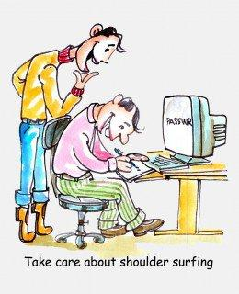
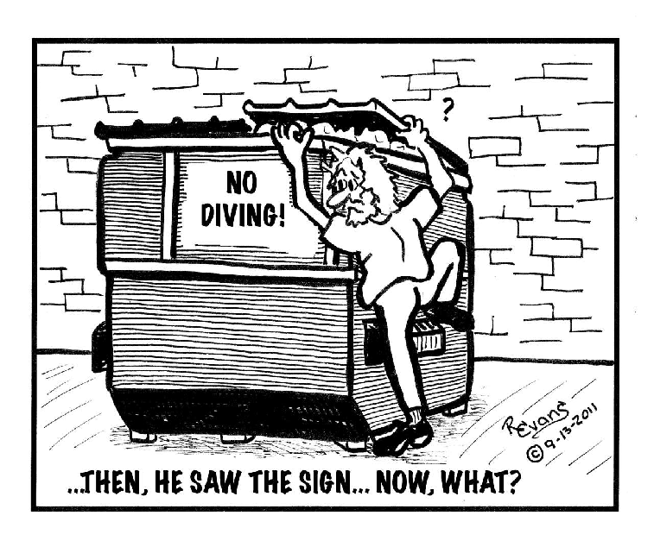
Human Based (Non Technical)
Impersonating an employee or valid user : Posing employee of same organisation.
Posing as an important user : Pretend to be an important user
Using a third person : By authorised source to use system
Calling technical support : By using Help desk
Shoulder surfing : By watching over a person shoulder
Dumpster diving : Looking in trash for information

Slide 13
2. Computer Based Social Engineering
Fake EMails
Email Attachments
Pop-up Windows
Protecting Yourself from Social Engineering Attack
Network defenses to repel virus
Virus protection (McAfee, Norton, Symantec, etc…)
Email attachment scanning
Firewalls, etc…
Organizations must decide what information is sensitive
Security must be periodically tested
Contact your security office immediately if you have any concerns at work

Slide 14
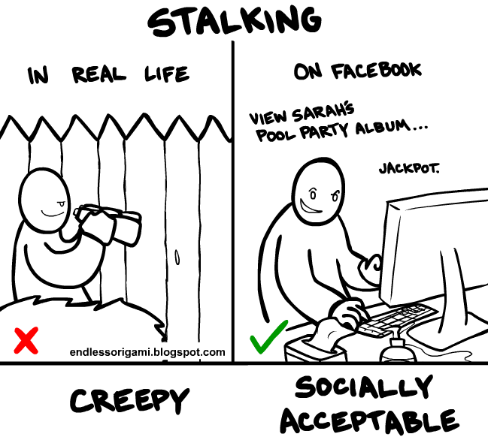
Cyber Stalking
Definition::
It is a crime in which the attacker harasses a victim using electronic communication, such as e-mail or instant messaging (IM), or messages posted to a Web site or a discussion group.
Stalking :
A cyberstalker relies upon the anonymity afforded by the Internet to allow them to stalk their victim without being detected.
Cyberstalking messages differ from ordinary spam.
Cyberstalker targets a specific victim with often threatening messages, while the spammer targets a multitude of recipients with simply annoying messages.

Slide 15
Types of Stalkers
Mainly 2 types :
Online Stalkers :
Def: Interaction with the victim using Internet.
Ex: Email, Chat
Offline Stalkers:
Def: Begin the attack using traditional methods.
Ex: Watching daily, Personal websites.
Other types :
The four most important types are:
Rejected Stalker
Resentful Stalker
Predatory Stalker
Intimacy Stalker

Slide 16
Rejected Stalker
Most common, persistent, and intrusive
Obsessed with someone who is a former romantic partner or friend, and who has ended their relationship, or indicates that he or she intends to end the relationship.
Resentful Stalker
Looking for revenge against someone who has upset them--it could be someone known to the stalker or a complete stranger.
Their behaviors are meant to frighten and distress the victim
Predatory Stalker
Least common
Are a classic sexual predator whose plan is to physically or sexually attack the victim.
Their motivated purely by the desire for sexual gratification and power over their victim
Intimacy Stalker
They seeks to establish an intimate, loving relationship with their victim.
The victim and himself were “meant to be together.”
These types of people think that the victim owes them love and affection because of all the time and effort it took for the stalker to stalk them.

Slide 17
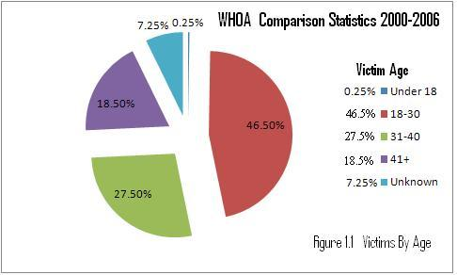
Analysis…
The majority of cyberstalkers are men and the majority of their victims are women but…..
Jane A. Hitchcock, president of WHOA says, “The most surprising thing we've seen is the rise in female cyberstalkers - this increased from 27% in 2000 to 35% in 2002 to 38% in 2003.”
According to the Working to Halt Online Abuse (WHOA) from 2000 to 2006, out of the total cases, 2036, of cyberstalking….

Slide 18
How stacking works?
In the following way
Personal information gathering about the victim.
Ex: Name, background, contact number, etc.
Establish a contact with victim through phone.
Stalkers will almost always establish a contact with the victims through EMail.
Some stalkers keep on sending repeated E-mail.
Post victims personal information on any illicit services website
Who were received information , start calling the victims on the given contact details.
Stalkers subscribe/register the E-mail account of the victim to pornographic and sex sites.
Real Life Incident:
Case study: In Delhi, 40 calls in 3 days.

Slide 19
Cybercafe and Cybercrimes
Cybercrimes such as stealing of bank passwords and subsequent fraudulent withdrawal of money have also happened through cybercafes.
Cybercafes have also been used regularly for sending obscene mails to harass people.
Indian Information Technology Act (ITA) 2000 interprets cybercafes as “network service providers” referred to under the erstwhile Section 79, which imposed on them a responsibility for “due diligence” failing which they would be liable for the offenses committed in their network.

Slide 20
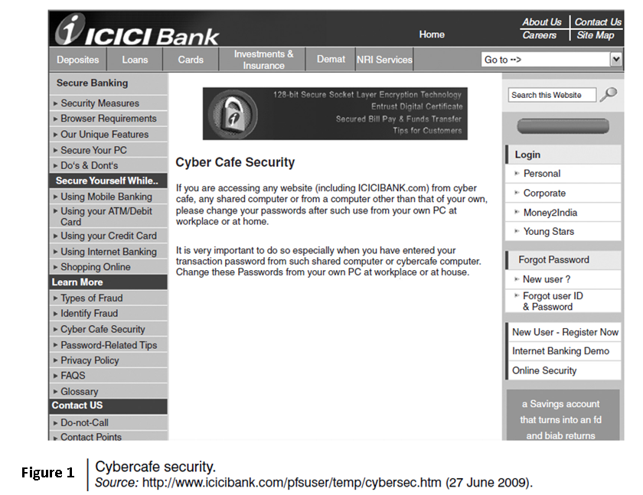

Slide 21
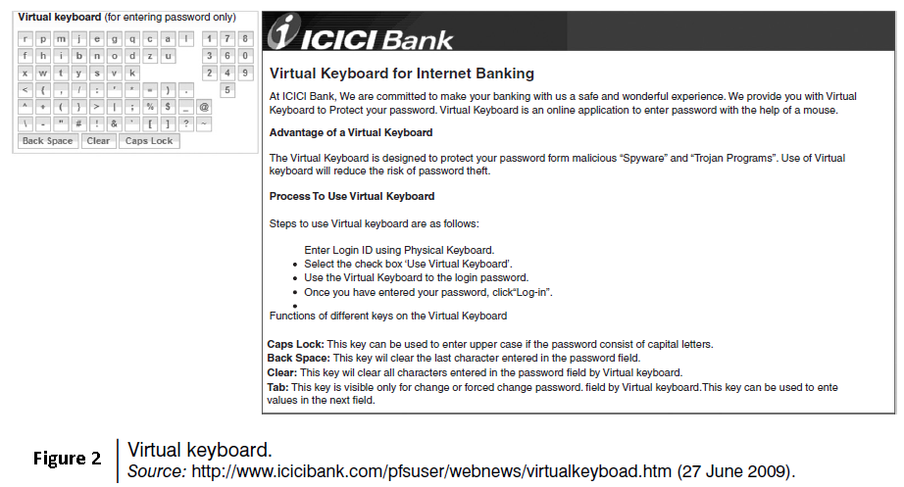

Slide 22
Cybercriminals can either install malicious programs such as keyloggers and/or Spyware or launch an attack on the target.
Here are a few tips for safety and security while using the computer in a cybercafe:
Always logout
Stay with the computer
Clear history and temporary files
Be alert
Avoid online financial transactions
Change passwords
Virtual keyboard
Security warnings

Slide 23
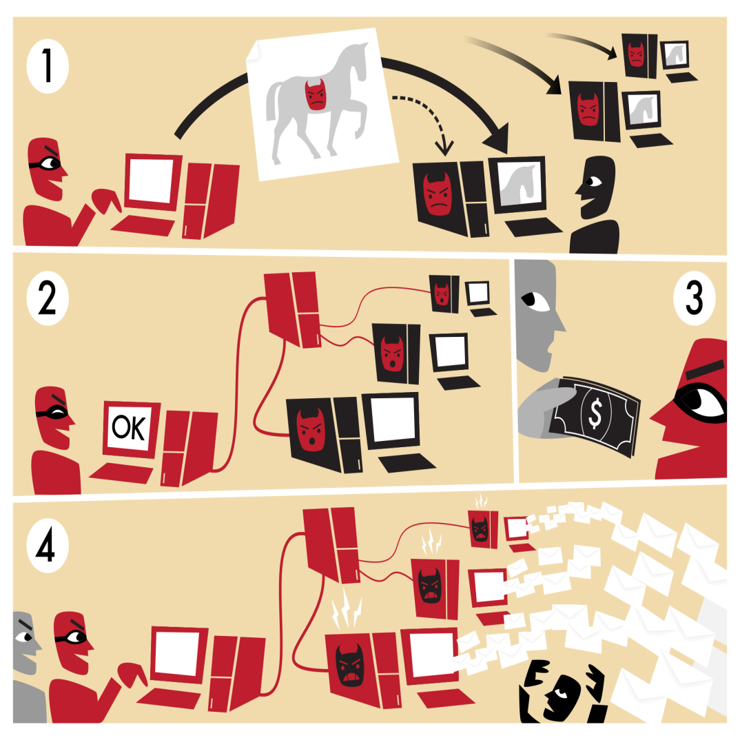
Botnet: The fuel of Cybercrime
A Botnet (also called as zombie network) is a network of computers infected with a malicious program that allows cybercriminals to control the infected machines remotely without the users’ knowledge.
Your computer system maybe a part of a Botnet even though it appears to be operating normally.
Botnets are often used to conduct a range of activities, from distributing Spam and viruses to conducting denial-of-service (DoS) attacks.
Evolution of Botnets
Motivation change in computer hacking
Vandalism 🡪 Financial gains
Loss of $67.2 billion (2006 figure)

Slide 24
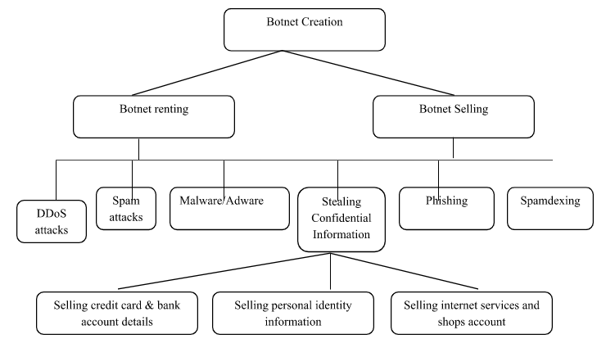
How botnets creates the business

Slide 25
One can ensure following to secure the system:
Use antivirus and anti-Spyware software and keep it up-to-date.
Set the OS to download and install security patches automatically.
Use a firewall to protect the system from hacking attacks while it is connected on the Internet.
Disconnect from the Internet when you are away from your computer.
Downloading the freeware only from websites that are known and trustworthy
Check regularly the folders in the mail box – “sent items” or “outgoing” – for those messages you did not send.
Take an immediate action if your system is infected.

Slide 26
Attack Vector
An “attack vector” is a path or means by which an attacker can gain access to a computer or to a network server to deliver a payload or malicious outcome.
Attack vectors include viruses, E-Mail attachments, webpages, pop-up windows, instant messages, chat rooms, and deception.
The most common malicious payloads are viruses, Trojan Horses, worms, and Spyware.
If an attack vector is thought of as a guided missile, its payload can be compared to the warhead in the tip of the missile.
Payload means the malicious activity that the attack performs.
It is the bits that get delivered to the end-user at the destination.

Slide 27
The attack vectors described here are how most of them are launched:
Attack by EMail
Attachments (and other files)
Attack by deception
Hackers
Heedless guests (attack by webpage)
Attack of the worms
Malicious macros
Foistware (sneakware)
Viruses

Slide 28
Cloud Security
Cloud computing services, while offering considerable benefits and cost savings makes it easier for cybercriminals to attack these systems.
Cloud computing is Internet (“cloud”)-based development and use of computer technology (“ computing”).
A cloud service has three distinct characteristics which differentiate it from traditional
hosting:
It is sold on demand
it is elastic in terms of usage
the service is fully managed by the provider.
Advantages of Cloud Computing
Cloud computing has following advantages:
1. Applications and data can be accessed from anywhere at any time.
2. It could bring hardware costs down.
3. Organizations do not have to buy a set of software or software licenses for every employee and the organizations could pay a metered fee to a cloud computing company.
4. Organizations do not have to rent a physical space to store servers and databases. Servers and digital storage devices take up space.
5. Organizations would be able to save money on IT support because organizations will have to ensure about the desktop (i.e., a client) and continuous Internet connectivity instead of servers and other hardware.

Slide 29
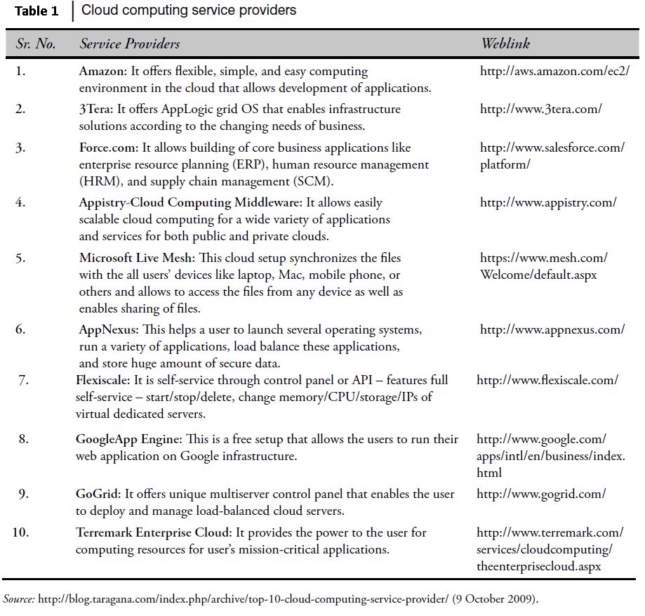
The cloud computing services can be either private or public.
A public cloud sells services to anyone on the Internet.
A private cloud is like a proprietary network or a data center that supplies the hosted services to a limited number of people.
Types of Services
Services provided by cloud computing are as follows:
Infrastructure-as-a-service (IaaS)
Platform-as-a-service (PaaS)
Software-as-a-service (SaaS)

Slide 30
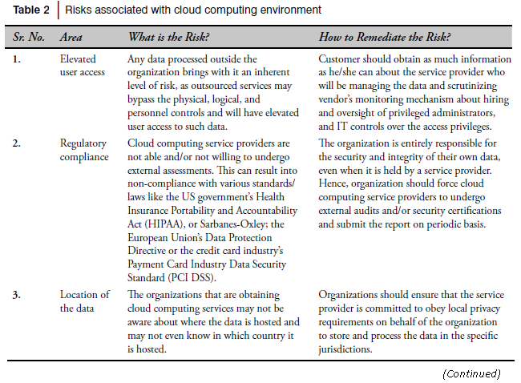
Cybercrime and Cloud Computing
Prime area of the risk in cloud computing is protection of user data.
Table 2 shows the major areas of concerns in cloud computing domain.

Slide 31
